Slide 1
Different Color
Software Studio 軟體設計與實驗
Hung-Kuo Chu
Department of Computer Science
National Tsing Hua University
CS2410

Slide 2
Important
We use Cocos Creator 2.4.8 in this course.
Please make sure you use the same version, otherwise your program may crash when we test it.

Slide 3
Goal
Fork repo Lab09-Different Color to your local repository
Complete all TODOs written in Menu.ts and GameManager.ts to create an eye test game

Slide 4
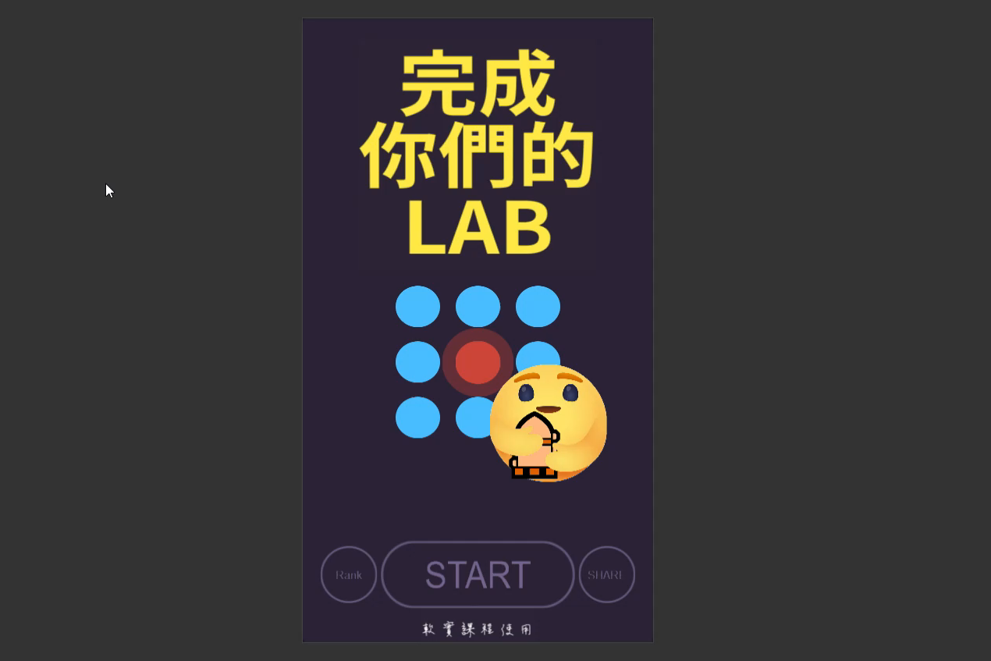
Goal (Cont'd)
Example Result
DEMO URL: https://eccioa.gitlab.io/lab09-demo/
Deadline: 2022/04/26 17:20

Slide 5
Grading Policy
Clicking the start button in the menu scene will load the game scene. (10%)
Can create the correct number of circles in circleContainer. (20%)
All circles are correct in size and placed in the correct position. (25%)
Can correctly use the color that has been decided to distinguish which circle is the only answer, and have the correct click event. (25%)
All audio is played correctly. (20%)
You will get 0 point if your program crashes during the test.

